Slide 1

Causes of Death in US
Visualization Final Project
Team9: Temirlan Ulugbek uulu, Zhao Liu

Slide 2
Introduction & Motivation

Slide 3
Design Idea
Rank of Cause of Death in each state
Trend of Death rate
Patterns according to maps

Slide 4
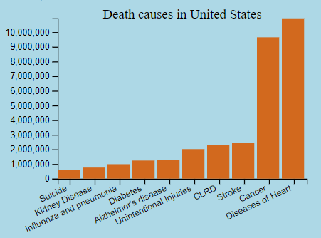
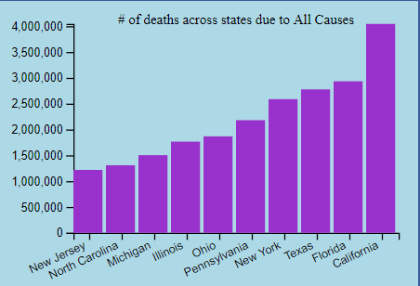
Bar chart

Slide 5
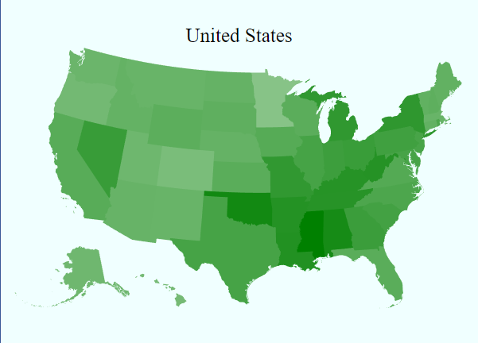
Heat Map
Notes:
Avg. death count for heart diseases heat map

Slide 6
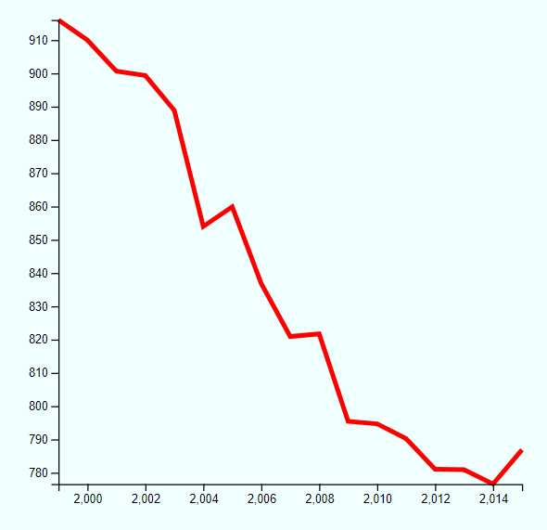
Line Chart

Slide 7
Techniques Used
Filtering
Zoom
Linking & Brushing
tooltip

Slide 8
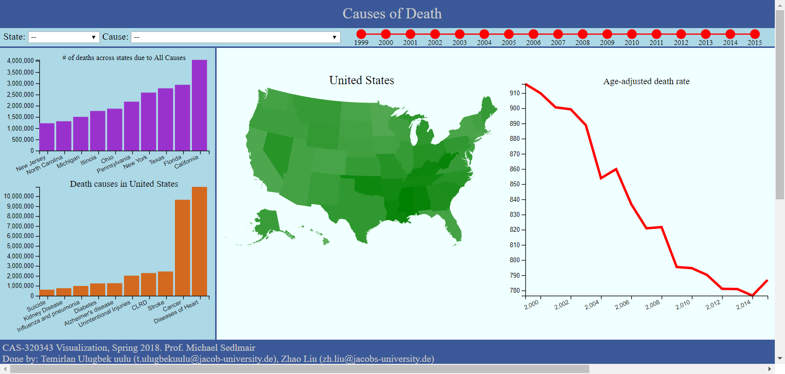

Slide 9
Demo

Slide 10
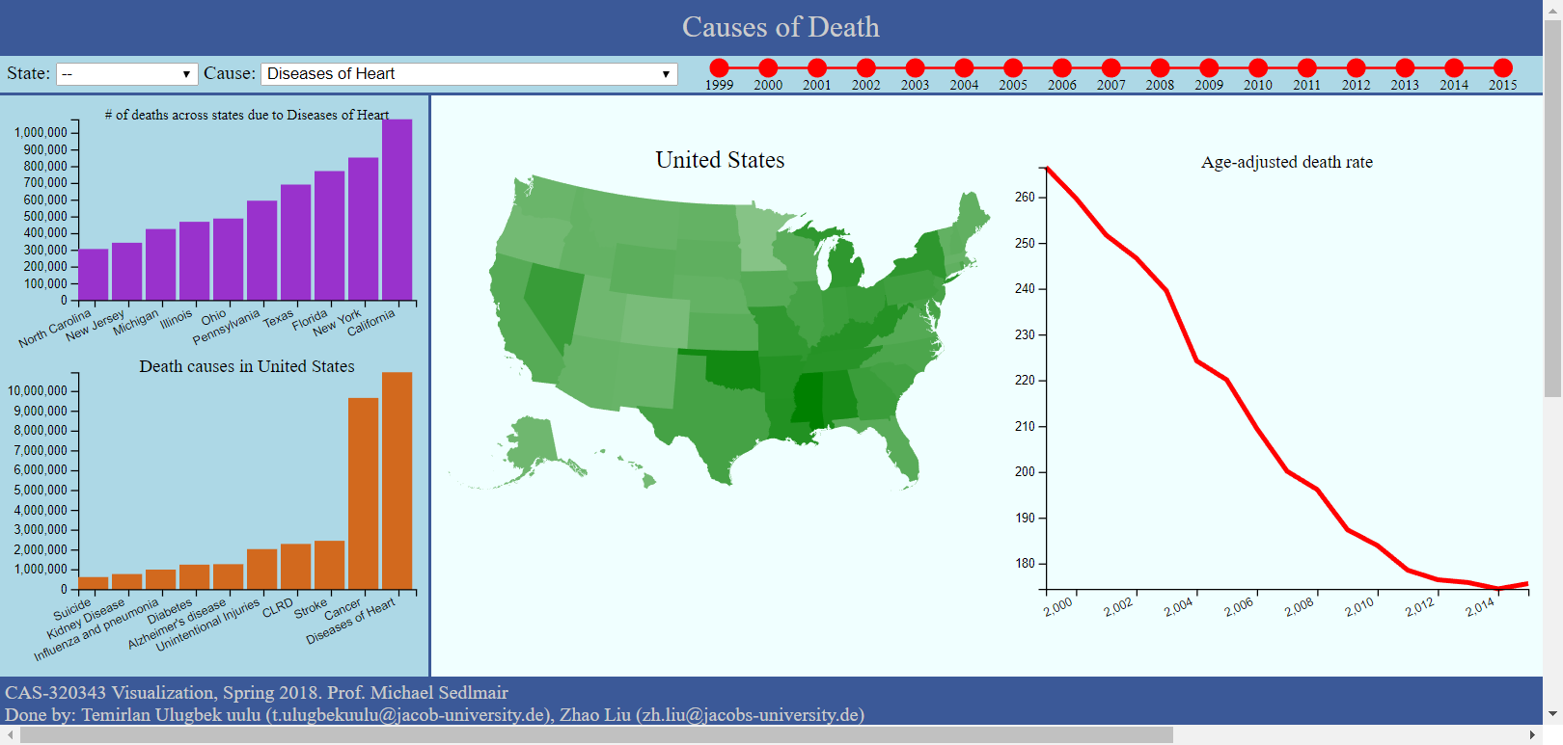
Case 1: Diseases of Heart&Cancer

Slide 11
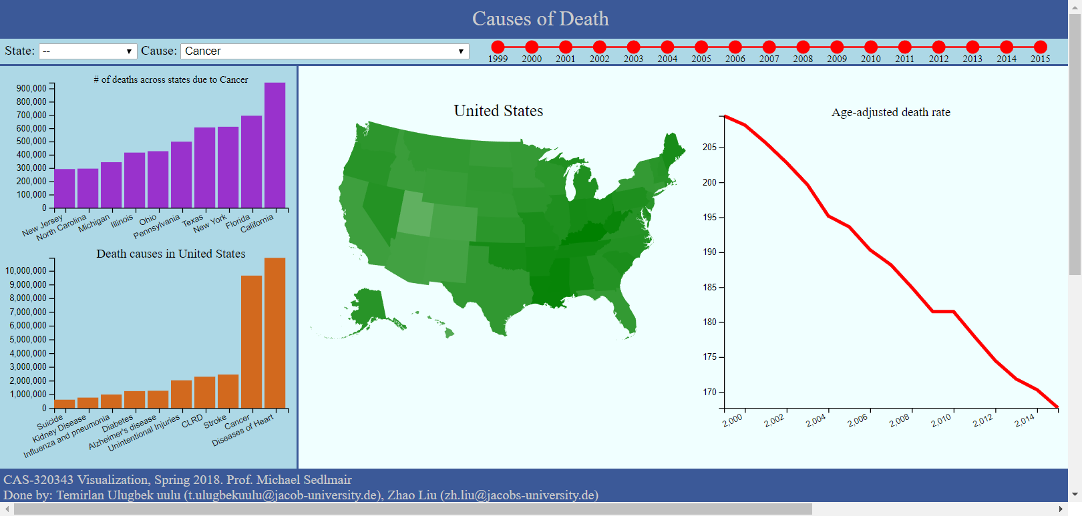
Case 1: Diseases of Heart&Cancer

Slide 12
Case 1 Conclusion & Assumption
Heart Diseases and Cancer are the top death causes in US
Death Count are drastically decreasing over the last 15 years
Cancer are genetic while heart diseases may relate more to life style.
…

Slide 13
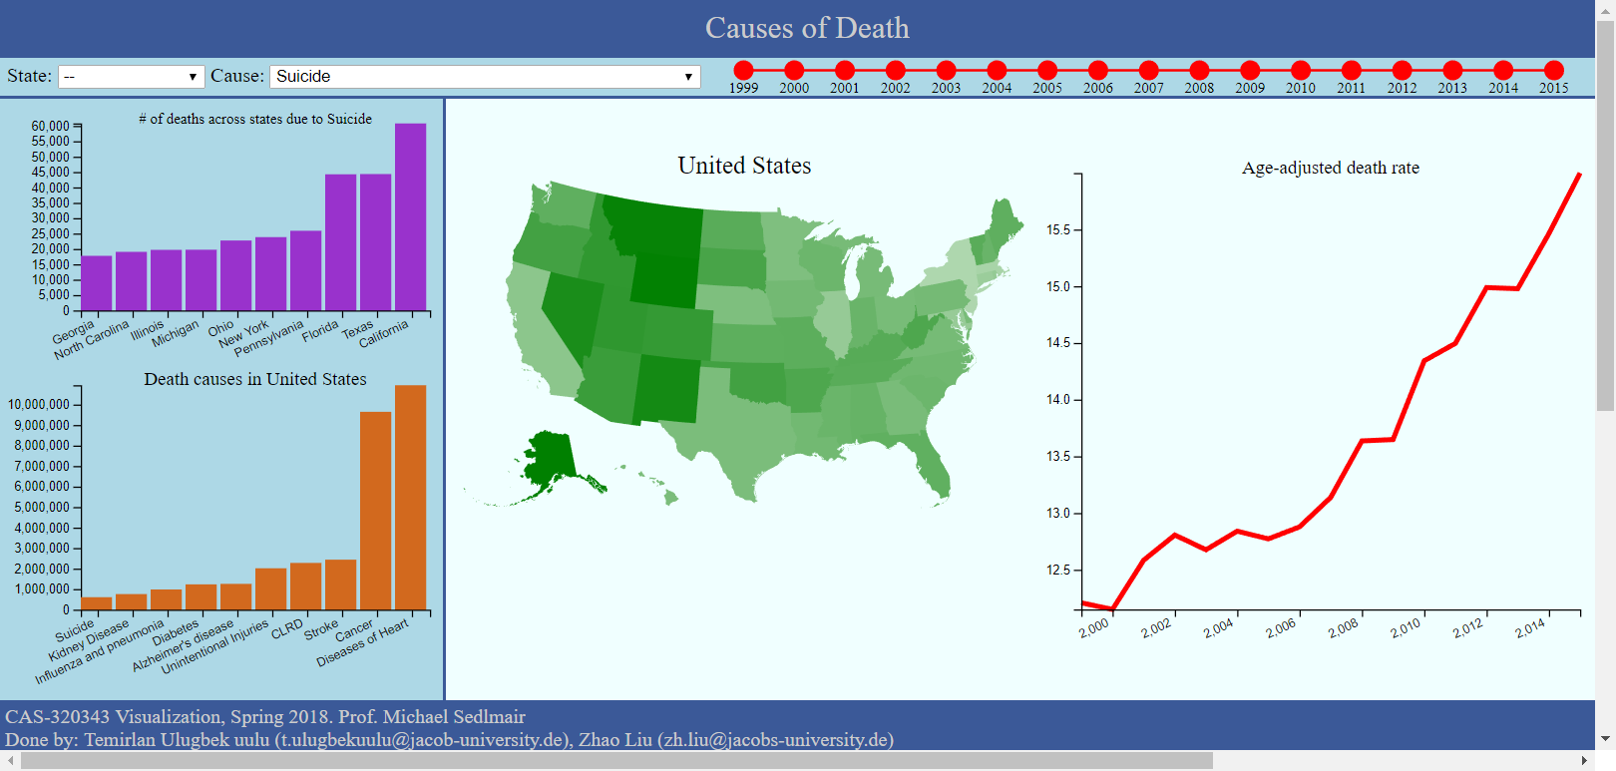
Case 2: Suicide

Slide 14
Thank you
Visualization Final Project
Team9: Temirlan Ulugbek uulu, Zhao Liu

